Slide 1

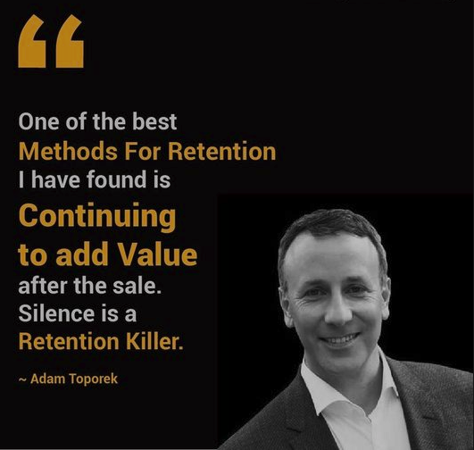
Customer Churn Prediction
Batch MIP-ML-08
Allan Cheerakunnil Alex

Slide 2
Agenda
Introduction
Steps involved to predict customer churn
Project summary
Understanding data
EDA - Exploratory Data Analysis
Basic data cleaning
Cleaning and transforming data
Conclusion

Slide 3
Introduction
Customer attrition also known as customer churn or customer defection, refers to the loss of customers or clients by a business over a certain period of time. It occurs when customers stop purchasing products or services from a company, discontinue their subscriptions or switch to competitors. It's crucial for the company to look after reasons why customers are leaving and should take steps to reduce the number of customers leaving.
One way to do it is by identifying customer segments that are at risk of leaving and implementing retention strategies to keep them. Also, by using data and machine learning techniques, companies can predict which customers are likely to leave in the future and take actions to keep them before they decide to leave.
We are going to build a basic model for predicting customer churn using Customer_Churn.csv file/dataset. We are using some classification algorithm to model customers who have left, using Python tools such as pandas for data manipulation and matplotlib for visualisations.

Slide 4
Steps Involved to Predict Customer Churn
Importing Libraries
Loading Dataset
Exploratory Data Analysis
Outliers using IQR method
Cleaning and Transforming Data
One-hot encoding
Rearranging Columns
Feature Scaling
Feature Selection
Prediction using Logistic Regression
Prediction using Support Vector Classifier
Prediction using Decision Tree Classifier
Prediction using KNN Classifier

Slide 5
Project Summary
By analysing historical customer data, businesses can predict which customers are at risk of churn and take proactive measures to retain them. This process includes data collection, preprocessing, feature engineering, model selection, training, evaluation, and deployment. Accurate churn prediction enables businesses to implement targeted retention strategies, optimize customer retention efforts and maximize revenue and profitability.

Slide 6
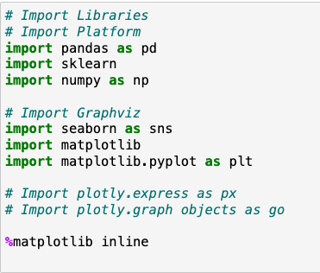
Understanding Data
Importing Libraries
Pandas - Data Manipulation
Sklearn - Scikit Learn Powerful Machine Learning Library
Numpy - Numerical Computation
Seaborn - Statistical Data Visualisation
Matplotlib - Data Visualisation
%Matplotlib inline - To display matplotlib inline within the notebook

Slide 7
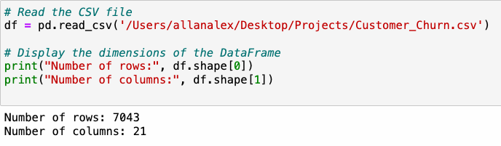
Dataset Loading
This line reads CSV file named Customer_Churn and stores the data into a Panda’s Data frame.
Df.shape[0] - Displays number of rows.
Df.shape[1] - Displays number of columns.

Slide 8
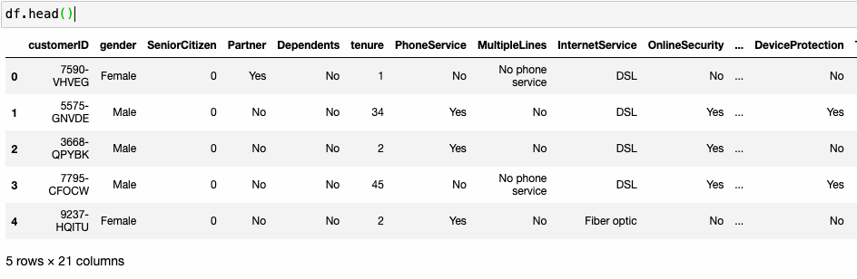
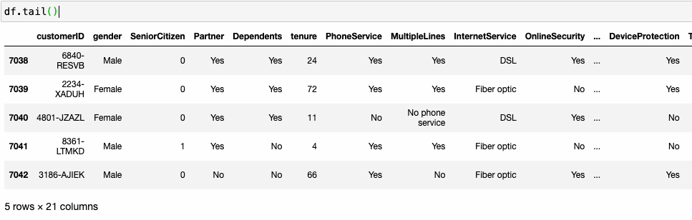
Exploratory Data Analysis
This is a quick way to inspect the structure and contents of the data frame.
Df.head() - It gives top 5 rows with columns.
Df.tail() - It gives bottom 5 rows and columns.

Slide 9

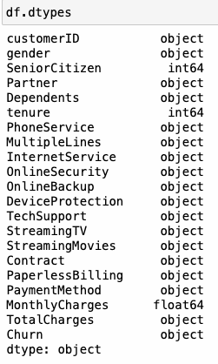

Df.shape - It displays rows and columns.
Df.size - It gives the total number of elements in the data frame.
Df.dtypes - It gives series containing the data type of each column in the data frame.

Slide 10
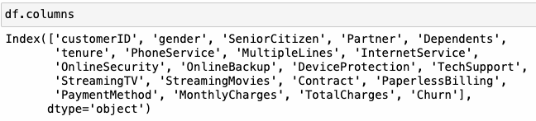
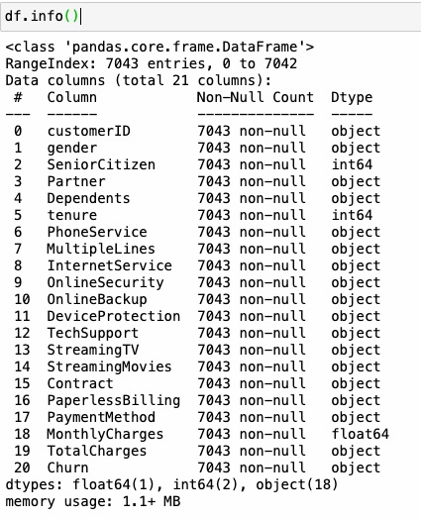
df.columns - It returns all columns in the data frame.
df.info() - It provides concise summary of the data frame.

Slide 11
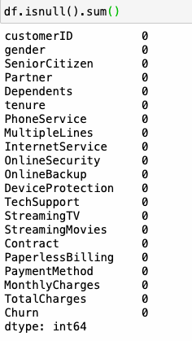

Df.isnull().sum() - It returns the number of missing values (null values) in each column of the data frame.
Df.duplicated().sum() - Calculates the number of duplicate rows.

Slide 12
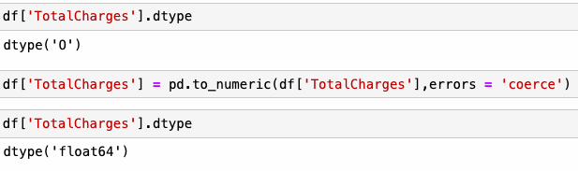
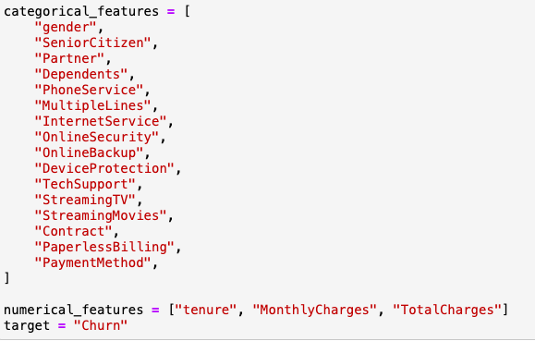
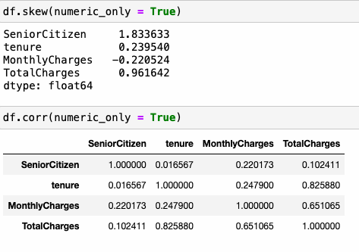
Basic Data Cleaning
df[‘TotalCharges’].dtype - It retrieves the data type of the total charges column.
df[‘TotalCharges’] = pd.to_numeric(df[‘TotalCharges’], errors = ‘coerce’) - Converts the value of TotalCharges column of the data frame df to numeric data type.
df[‘TotalCharges’].dtype - It displays data type after converting column into float.
Categorical_features and numerical_features - Two list created.
Target - Variable specifies or trying to predict the ‘Churn’.
Df.skew(numeric_only = True) - It calculates the skewness of the numerical columns. This helps in understanding the numerical variables in the dataset.
Df.corr(numeric_only = True) - It calculates the correlation matrix of the numerical columns in the data frame.

Slide 13
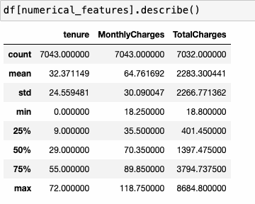
Numerical Features Distribution
Df.[numerical_features].describe() - This selects only the columns corresponding to the numerical features specified in the numerical features list and computes various descriptive statistics for each numerical features.

Slide 14
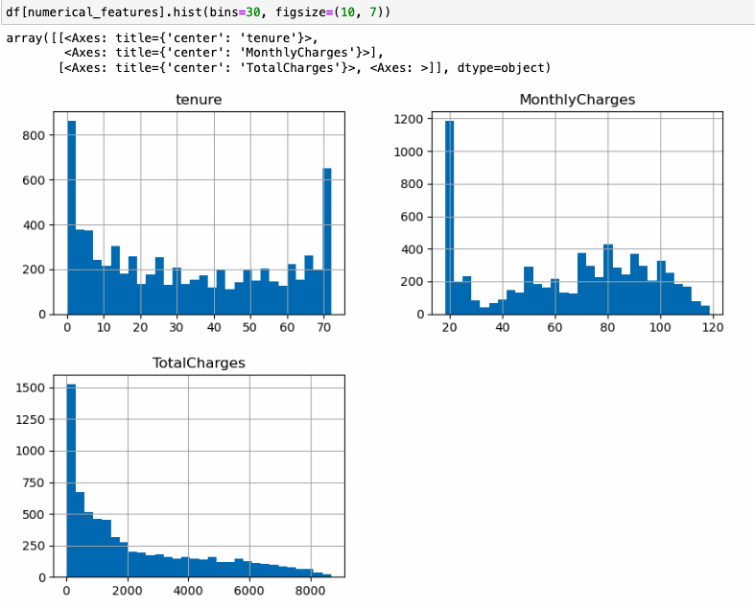
It creates a histogram for each numerical features specified in the list ‘numerical_features’ from the data frame.
Columns shown is Tenure, Monthly Charges and Total Charges.
This histogram provides insights into the distribution and spread of each numerical variable in the dataset, helping to understand the characteristics of customer tenures, monthly charges, and total charges.

Slide 15
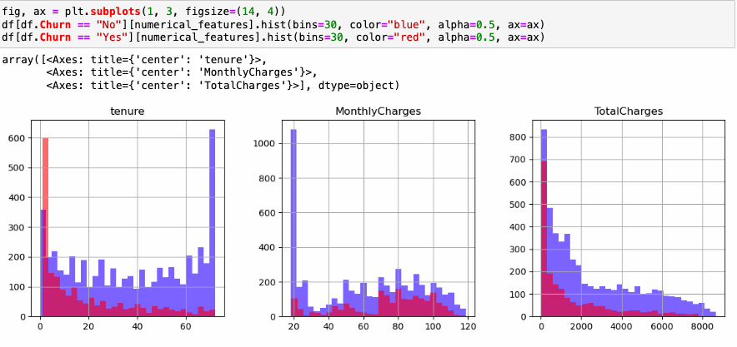
The resulting plot will have three subplots, each containing two histograms (one for "Churn = No" and one for "Churn = Yes") for the numerical features. This allows for a visual comparison of the distributions of numerical features between churned and non-churned customers.

Slide 16
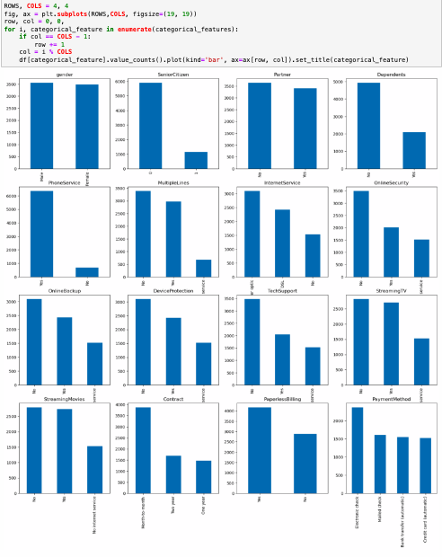
Categorical Features Distribution
The loop iterates over each categorical feature, plotting its counts as a bar chart on a separate subplot. If the number of features exceeds the number of subplots, additional features will be plotted on subsequent rows.

Slide 17
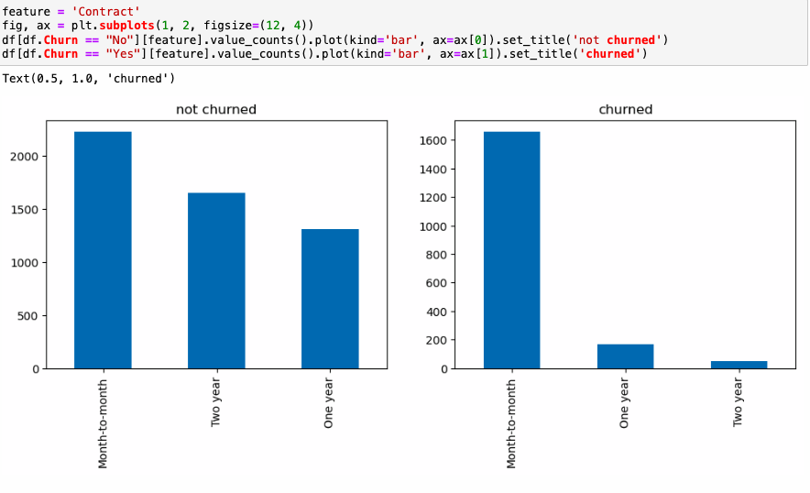
The resulting plot will have two subplots side by side, each showing the distribution of the 'Contract' feature for churned and not churned customers, respectively. This allows for a visual comparison of the distribution of the 'Contract' feature between churned and not churned customers.

Slide 18
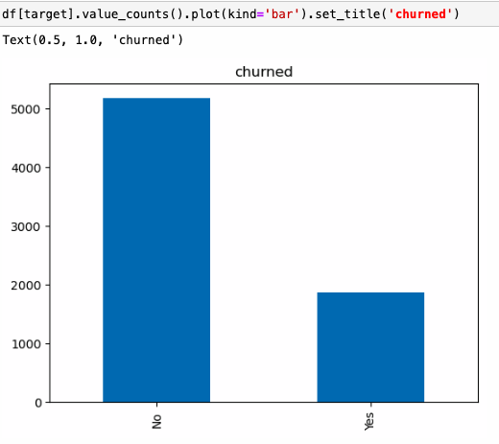
Target Variable Distribution
The resulting plot will have bars representing the counts of churned and not churned customers. This visualisation provides insights into the distribution of the target variable in the dataset, showing the proportion of customers who churned compared to those who did not.

Slide 19
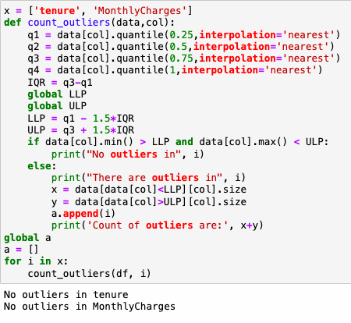
It will check if outliers are there in columns of Tenure and Monthly Charges.
And if present it will count and show the value.
If not it will show as No Outliers.

Slide 20
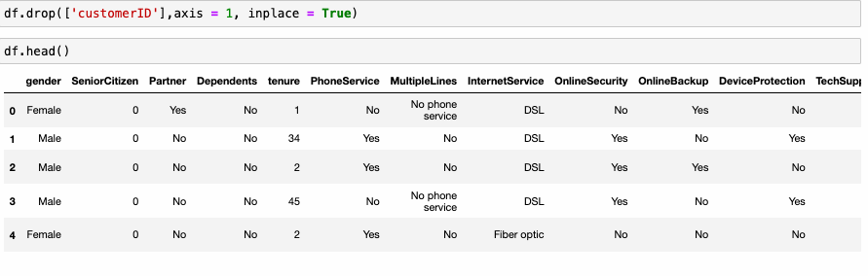
Cleaning And Transforming Data
Dropped Customer ID
It is no longer needed

Slide 21
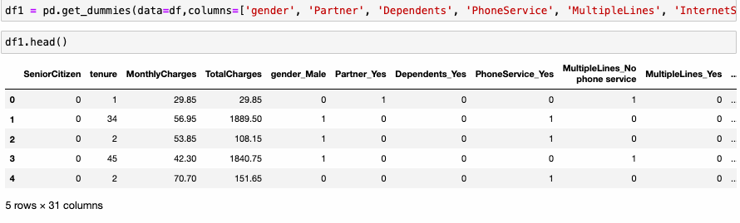
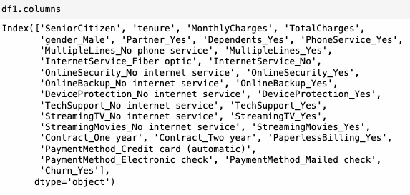

df1 = pd.get_dummies(data=df, columns=[‘gender’,- 'Churn'], drop_first=True)
This code performs one-hot encoding on categorical variables in the DataFrame, creating dummy variables for each category.
The DataFrame df1 will contain the original columns along with the newly created dummy variables for each category in the specified columns. This is useful for machine learning algorithms that require numerical input, as it converts categorical variables into a format that can be processed more easily.
Df1.colums - It displays the list of original columns along with dummy columns.
Df1.shape - It displays counts of rows and columns.

Slide 22
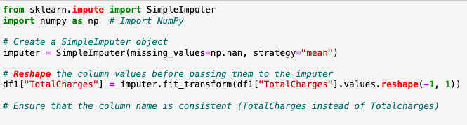
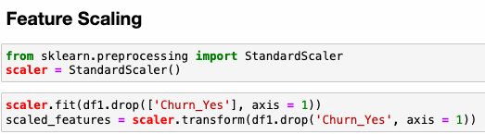
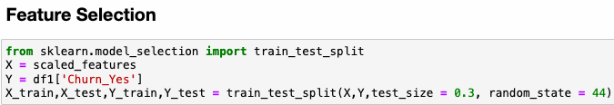
This code snippet imputes missing values in the “Total Charges” columns of ‘df 1’ using the mean strategy.
This code scales the features in the DataFrame df1 using the StandardScaler, which transforms the data such that it has a mean of 0 and a standard deviation of 1. This is a common preprocessing step in machine learning to ensure that all features are on a similar scale.
This code splits the data into training and testing sets, which are then used for training and evaluating machine learning models, respectively.

Slide 23
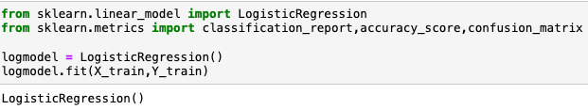
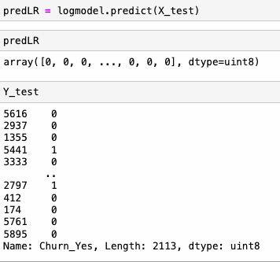
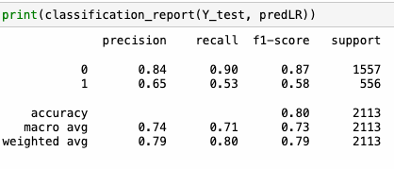
Prediction Using Logistic Regression
Log model will be a trained logistic regression model that can be used to make predictions on new data.
It contains predicted churn status for each observation in the test set. Each prediction indicates whether the corresponding customer is predicted to churn or not churn based on the logistic regression model.
The ‘Classification_report’ function from scikit-learn provides a comprehensive summary of the performance of a classification model. It calculates various metrics such as precision, recall, F1-score, and support for each class.

Slide 24
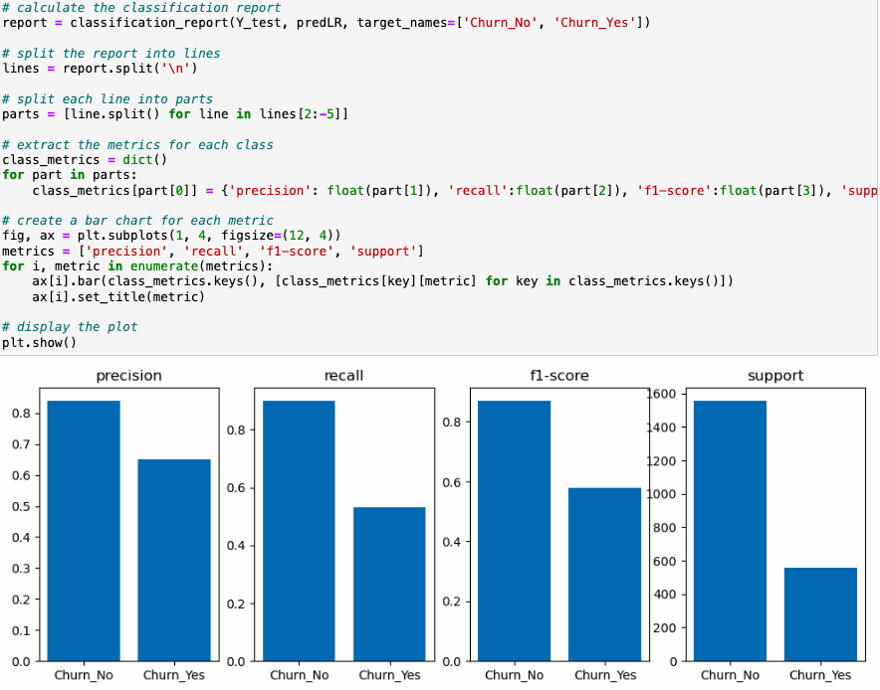
This code calculates the classification report using the ‘classification_report’ function from scikit-learn, then extracts the metrics for each class and creates a bar chart for each metric.
Code provides a visual representation of the precision, recall, F1-score, and support metrics for each class ('Churn_No' and 'Churn_Yes') in the classification report.

Slide 25
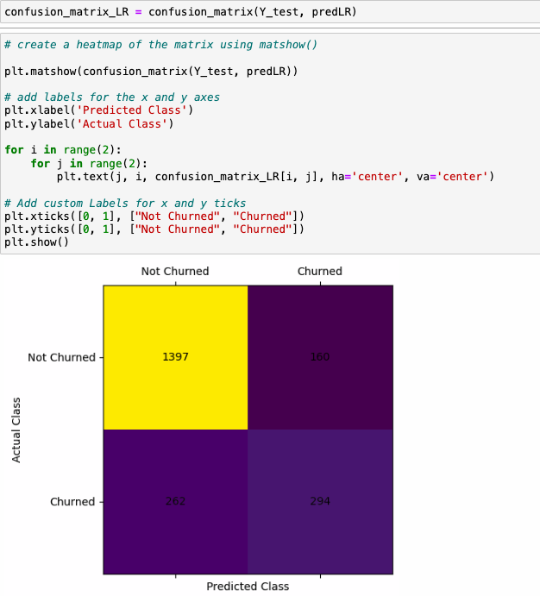
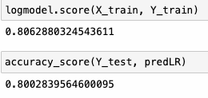
This code generates a heat map of the confusion matrix for the logistic regression model's predictions on the test data.
The heat map allows for easy interpretation of true positives, false positives, true negatives, and false negatives.
Both of these methods return the accuracy of the model, which is the proportion of correctly classified instances out of the total number of instances. It is a common evaluation metric for classification models.

Slide 26
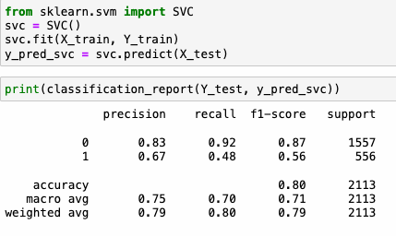
Prediction Using Support Vector Classifier
This code snippet trains a Support Vector Classifier (SVC) model on the training data and then generates a classification report to evaluate its performance on the test data.
This code snippet trains an SVC model, makes predictions on the test data, and then generates a classification report to assess the model's performance.

Slide 27
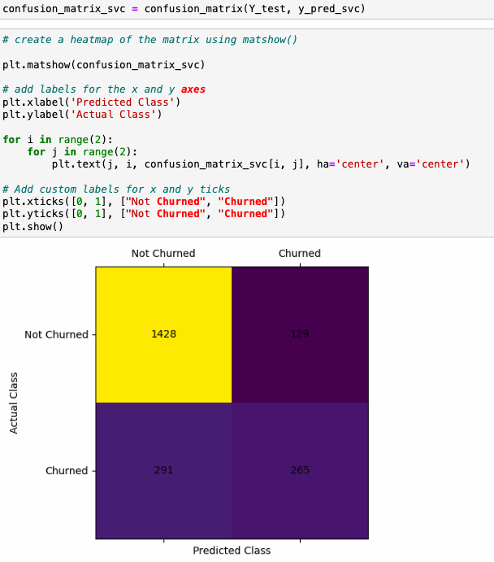
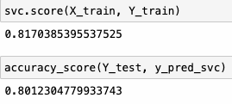
This code snippet creates a heat map of the confusion matrix for the Support Vector Classifier (SVC) model's predictions on the test data.
The heat map allows for easy interpretation of true positives, false positives, true negatives, and false negatives.
Both of these methods return the accuracy of the model, which is the proportion of correctly classified instances out of the total number of instances. It is a common evaluation metric for classification models.

Slide 28
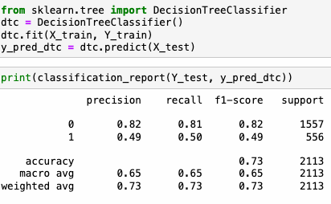
Prediction Using Decision Tree Classifier
This code snippet trains a Decision Tree Classifier model, makes predictions on the test data, and then generates a classification report to assess the model's performance.

Slide 29
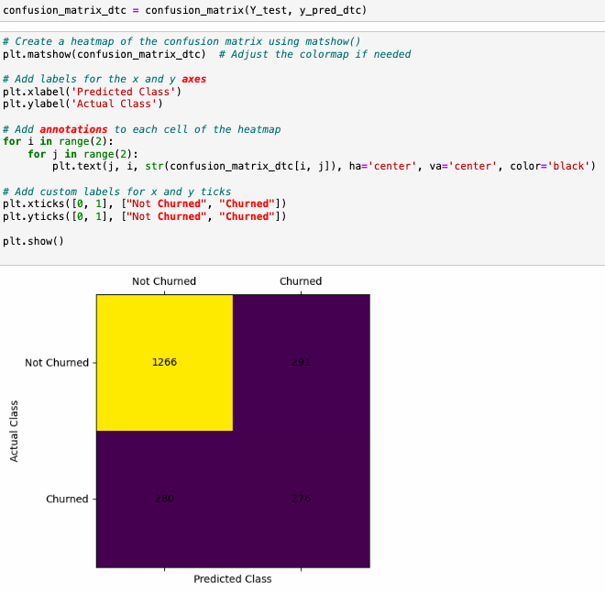
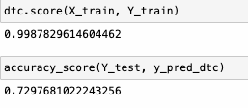
This code snippet creates a heat map of the confusion matrix for the Decision Tree Classifier (DTC) model's predictions on the test data.
This code provides a visual representation of how well the Decision Tree Classifier model's predictions align with the actual classes in the test data. The heatmap allows for easy interpretation of true positives, false positives, true negatives, and false negatives.
Both of these methods return the accuracy of the model, which is the proportion of correctly classified instances out of the total number of instances. It is a common evaluation metric for classification models.

Slide 30

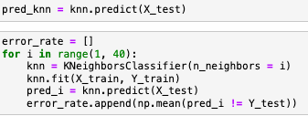
Prediction Using KNN Classifier
This code snippet creates and trains a K-Nearest Neighbour's (KNN) classifier using scikit-learn.
After executing this code, the KNN object will be a trained KNN classifier ready to make predictions on new data.
This code snippet calculates the error rate for different values of ’n neighbors'in a K-Nearest Neighbors (KNN) classifier.

Slide 31
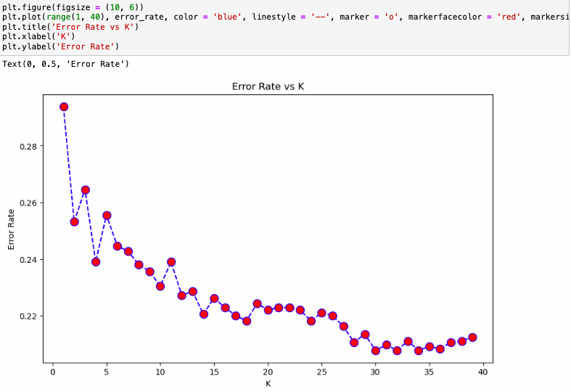
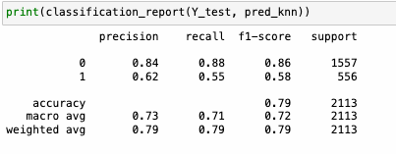
This code creates a plot that visualises how the error rate changes as the number of neighbour's (K) varies in the KNN classifier. It helps in selecting an appropriate value of K that minimises the error rate and improves the performance of the classifier.
The graph shows the relationship between the number of neighbour's (K) used in the K-Nearest Neighbour’s (KNN) classifier and the corresponding error rate on the test data.
The ‘Classification_report’ function provides a comprehensive summary of the performance of a classification model. It includes metrics such as precision, recall, F1-score, and support for each class.

Slide 32
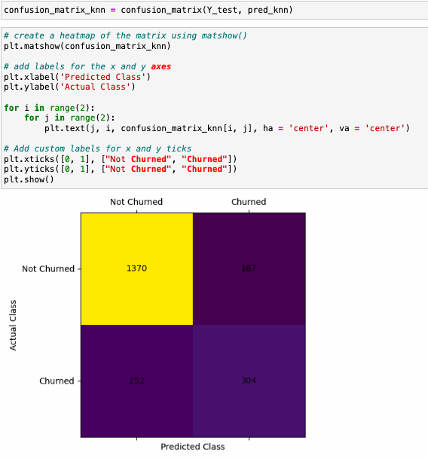
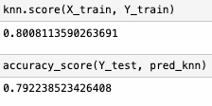
This code provides a visual representation of how well the predictions made by the KNN classifier align with the actual classes in the test data. The heat map allows for easy interpretation of true positives, false positives, true negatives, and false negatives.

Slide 33
Conclusion
Customer Churn Prediction is a vital step of maintaining business sustainability and growth in today's competitive landscape. By accurately forecasting which customers are likely to churn, businesses can proactively implement retention strategies, thereby reducing churn rates and preserving revenue streams. Through the analysis of historical data and the application of advanced machine learning algorithms, business can identity patterns and indicators that signal potential churn, enabling them to take actions.
To enhance Customer Churn Prediction and improve its effectiveness, several strategies can be implemented:
Data Quality Improvement
Feature Engineering
Advanced Analytics Technique's
Real Time Monitoring
Continuous Model Evaluation and Refinement

Slide 34
Thank You

